Slide 1
Airbnb – node
WDDM120 -Web Programming Application
Hailey Koo (N01382791)

Slide 2
Table of contents
pg. 3 - 6
Header, nav, search form
Promotional section
pg. 7
Room listing page
Informational section
Footer
pg. 8 - 11
Registration form
Log-in form
Registration validation
Log-in validation

Slide 3
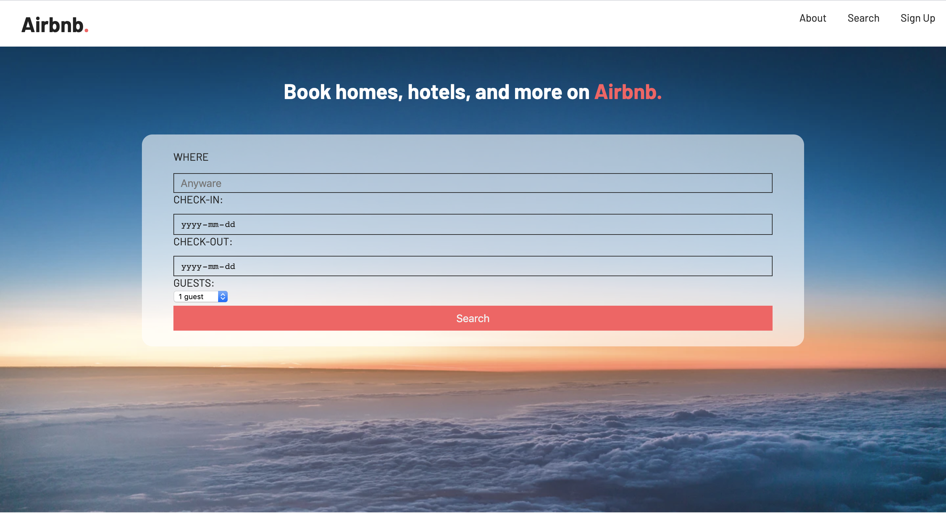
Homepage Header, nav bar, booking search form

Slide 4
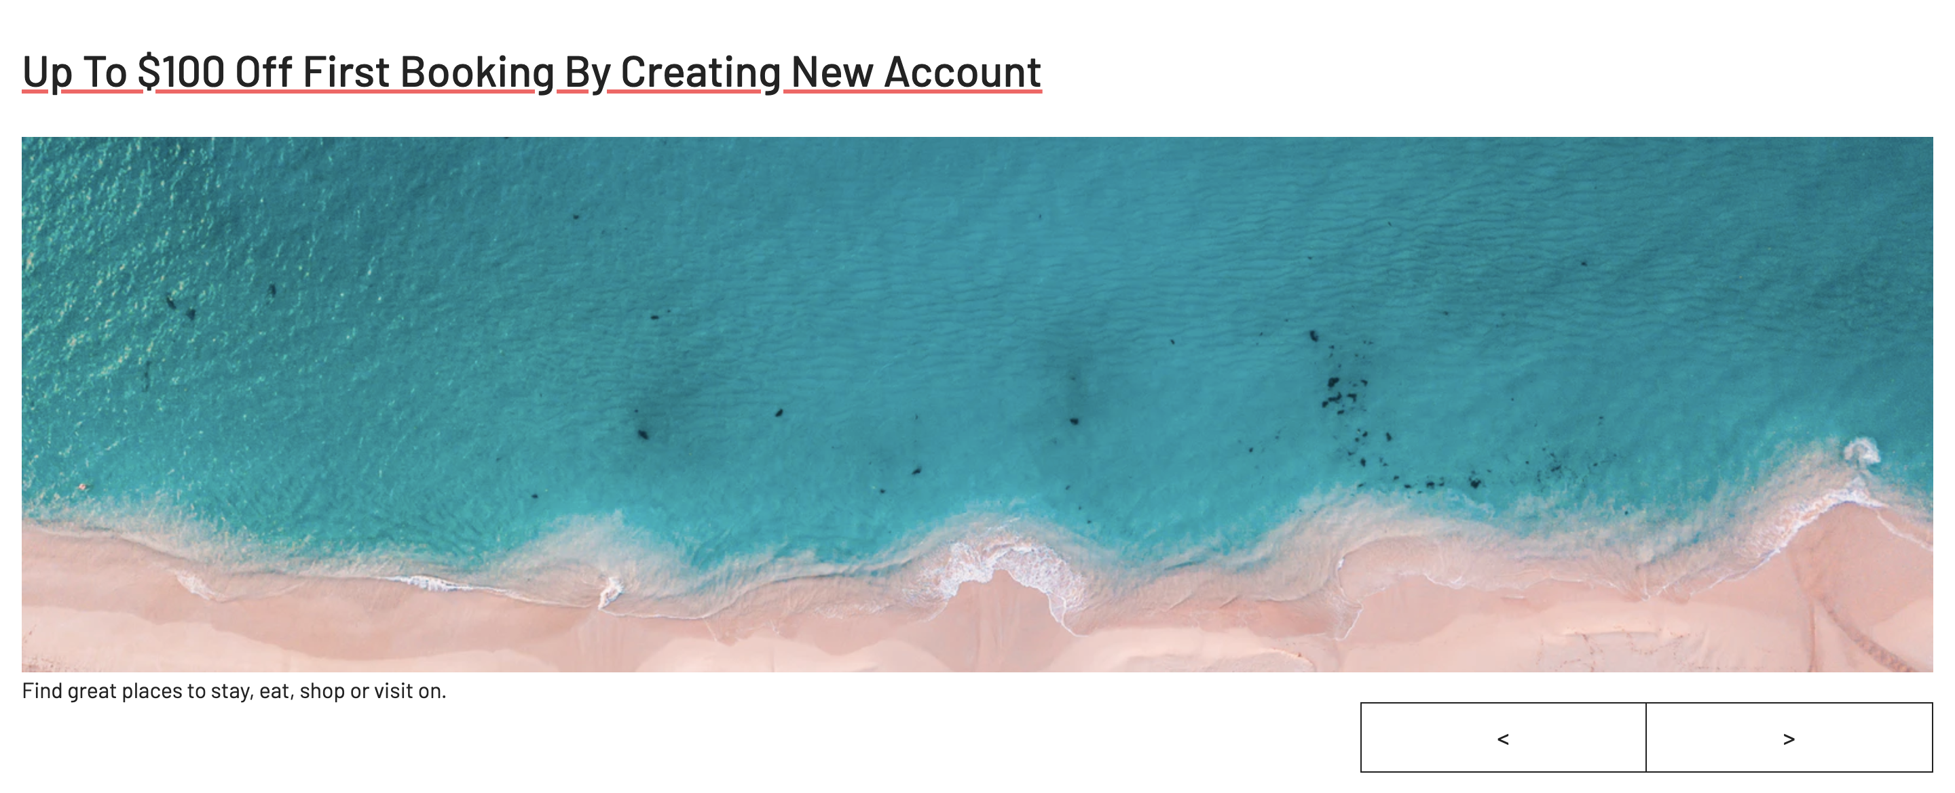
Homepage Promotional section
↓ Slide function has been added

Slide 5
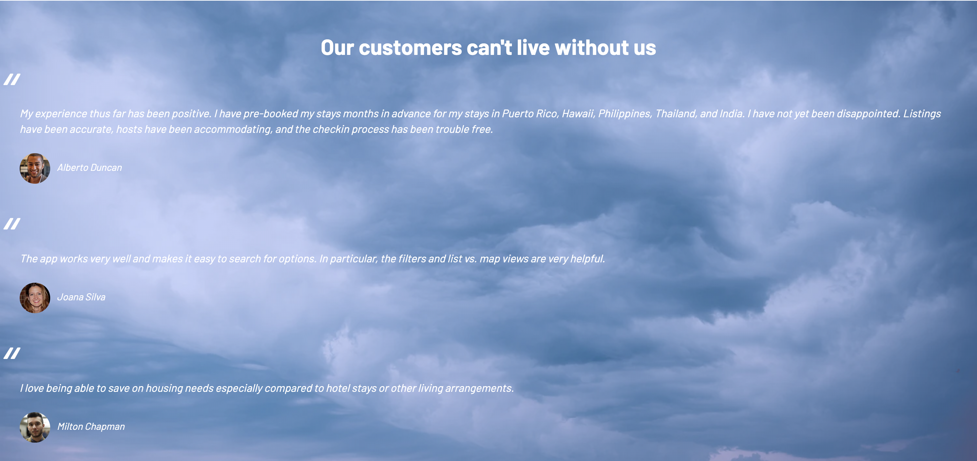
homepage Informational section

Slide 6

homepage footer

Slide 7
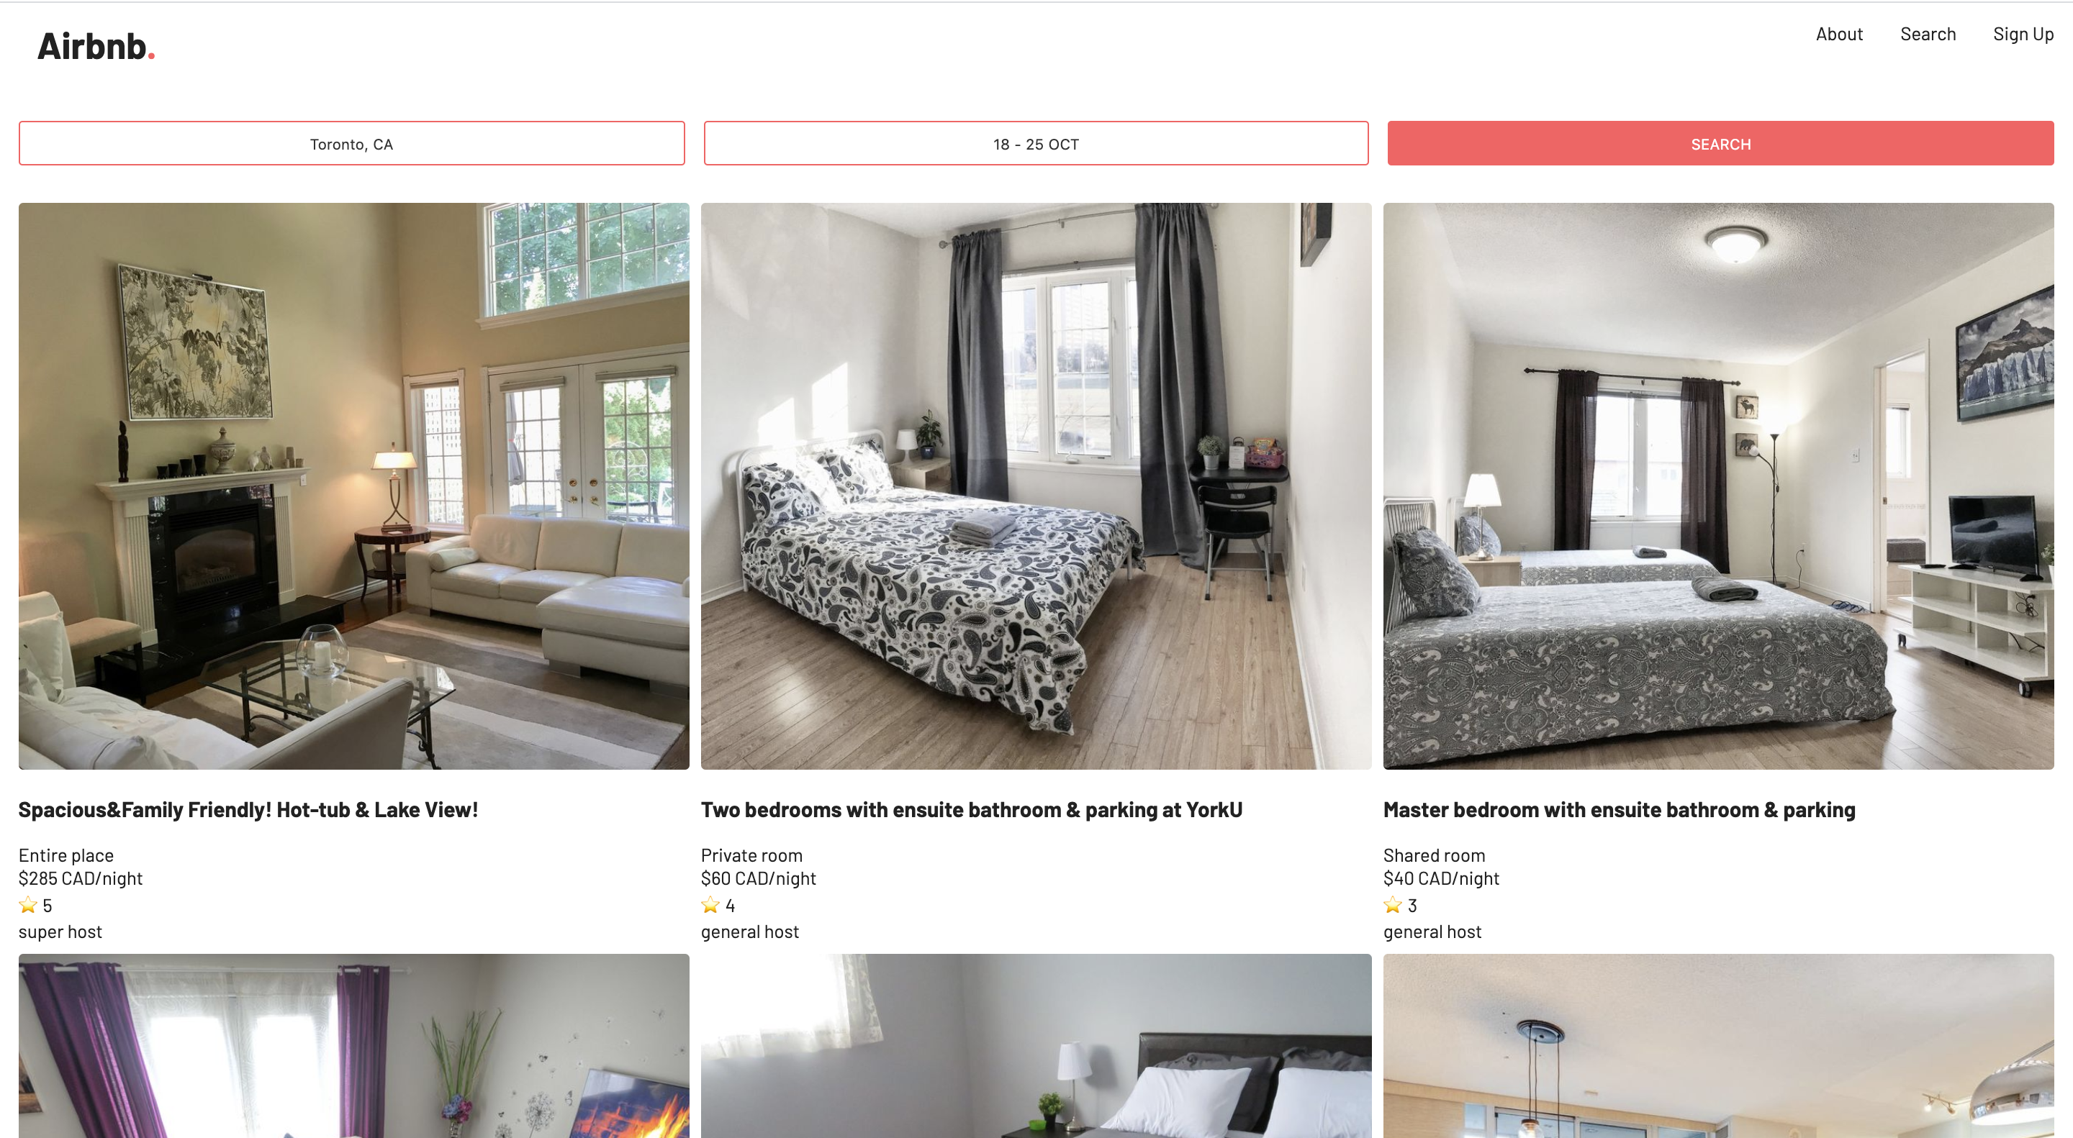
Room Listing View
Implemented features
- Header - Navigation
- 3 X 2 grid
- Footer

Slide 8
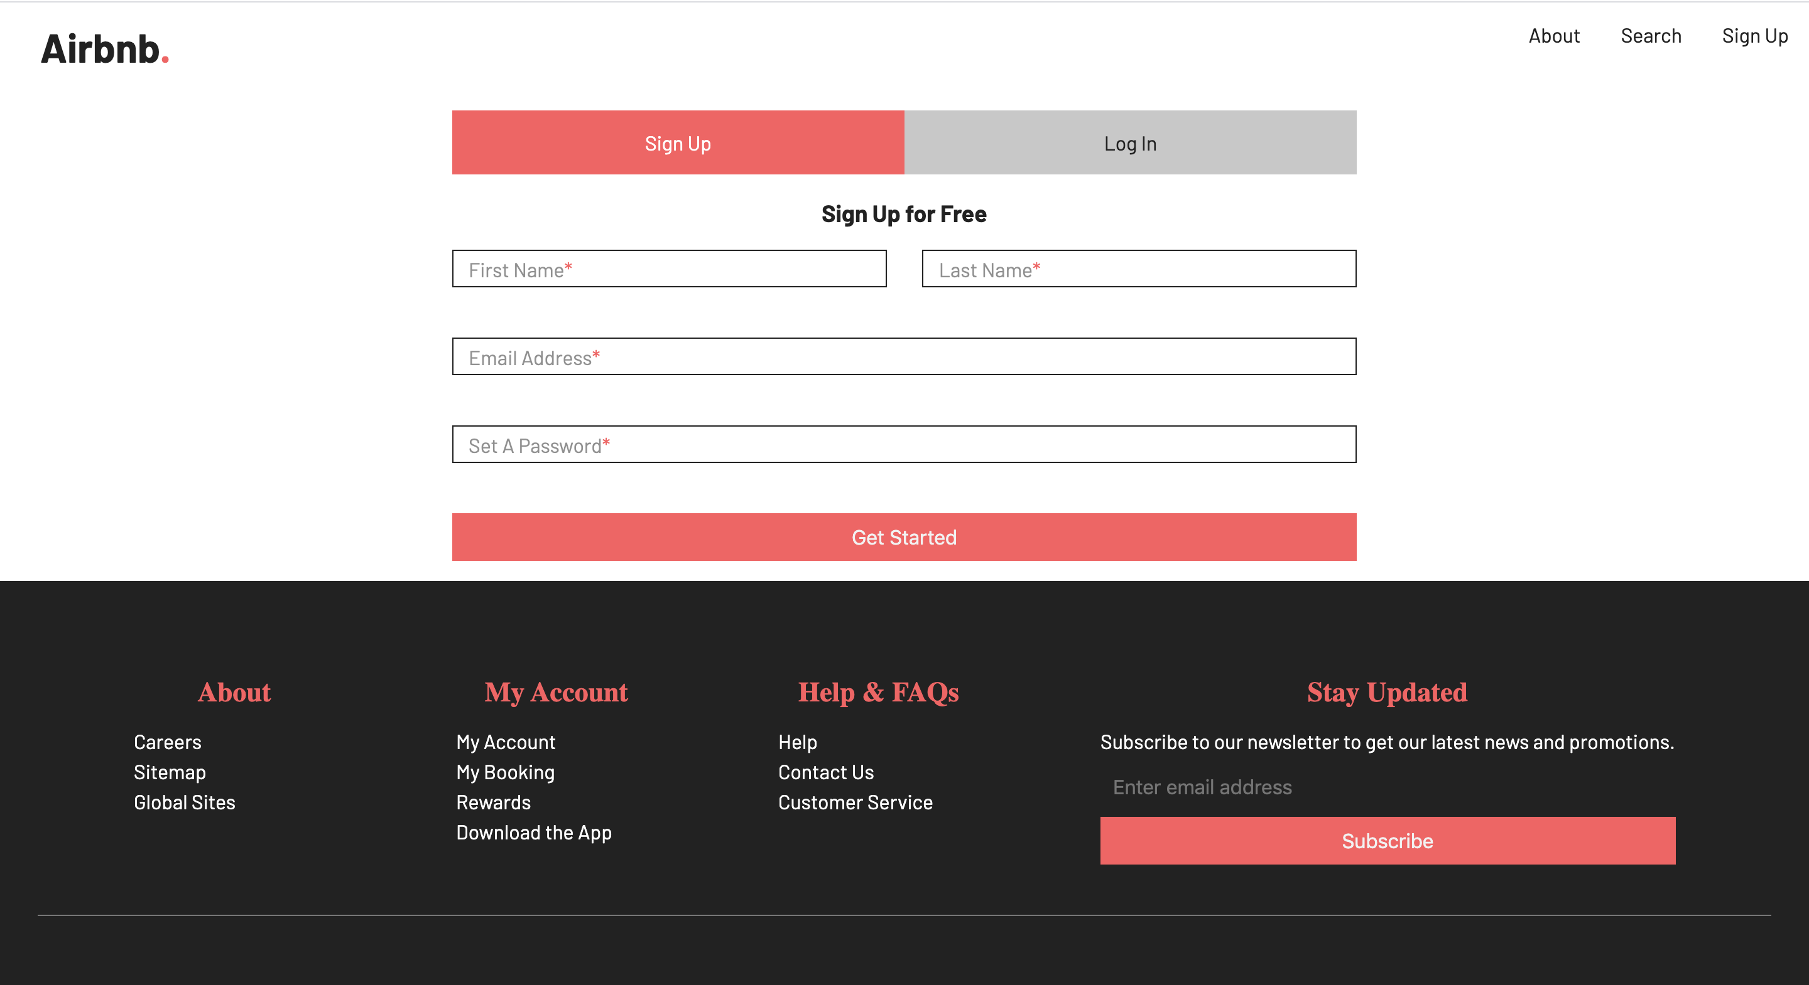
Registration View
Implemented features
- Registration form

Slide 9
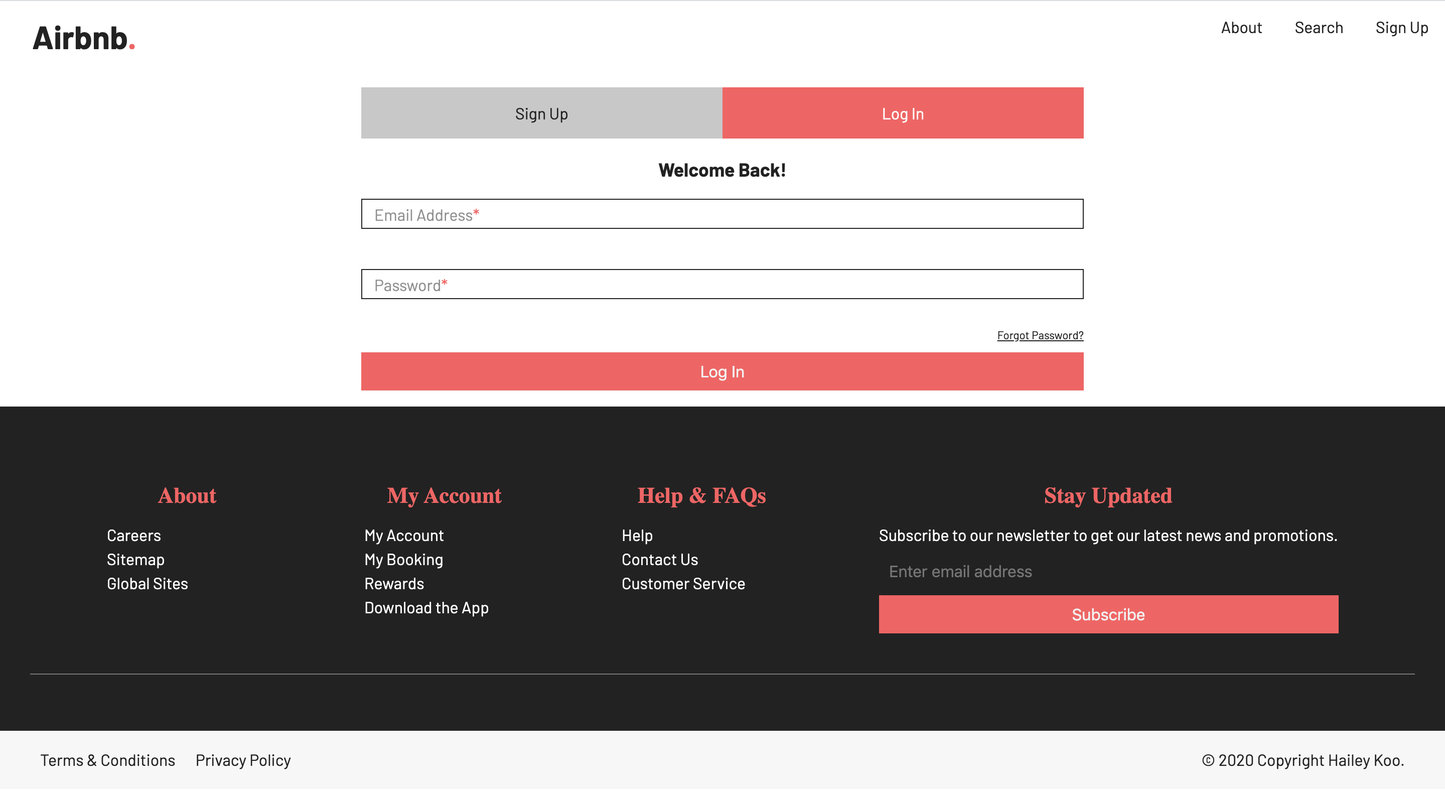
Log-in View
Implemented features
- Login Form

Slide 10
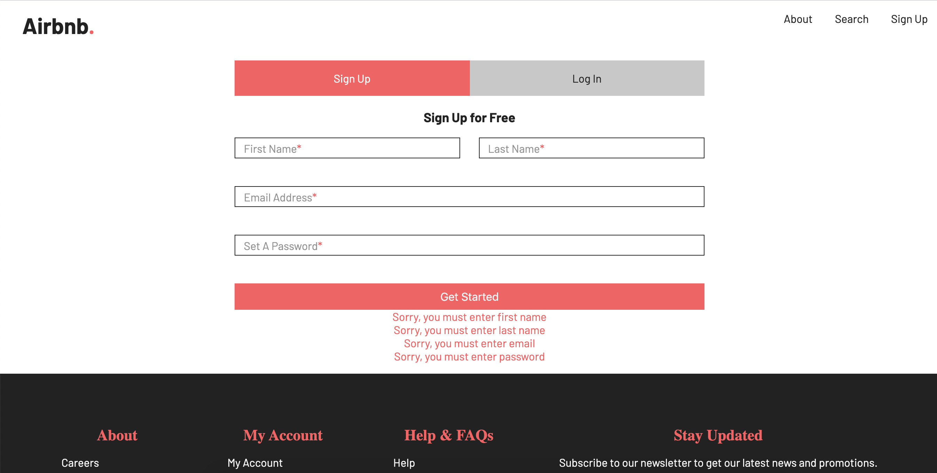
Registration form validation
Implemented features
Registration Validation
(Checking for nulls)
-------------------------
NOT Implemented
Advance Validation Criteria 1,2 (Registration Form)

Slide 11
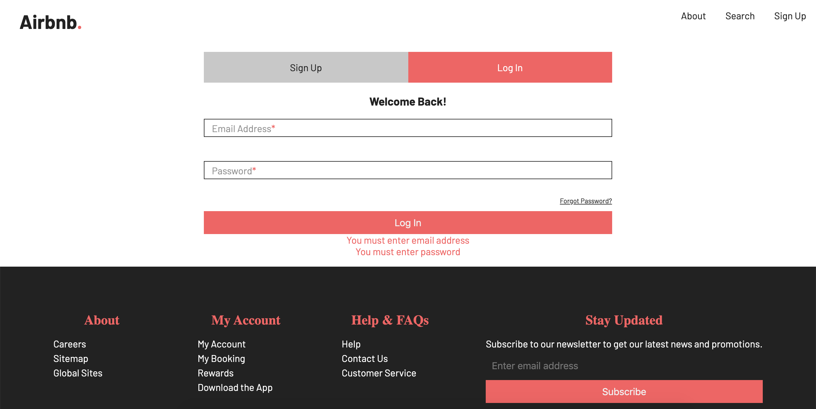
Log-in form validation
Implemented features
- Login Form Validation
(Checking for nulls)

